Slide 1
VINDHIYA K
Nmid: 847F879BAEF2299A258478F692D5629E
Madras Institute of Technology campus, Anna University
Final Project

Slide 2
PROJECT TITLE
Face Mask Detection using CNN
3/21/2024 Annual Review

Slide 3


AGENDA
This project aims to develop a system using Convolutional Neural Networks (CNNs) to detect if individuals in images or videos are wearing face masks. We'll gather a labeled dataset of faces with and without masks, preprocess it, and train a CNN model. This model will be integrated into an application to process live video or images, providing real-time mask detection results. The project will be evaluated based on accuracy, processing speed, and robustness to different conditions.
3/21/2024 Annual Review

Slide 4
PROBLEM STATEMENT
The COVID-19 pandemic has emphasized the importance of face mask usage. To enforce mask-wearing guidelines and ensure public safety, an automated system for mask detection is valuable. This project aims to address this need by developing a CNN-based system that can accurately identify individuals wearing masks in images or video streams. The challenge lies in training a robust model that performs well under varying lighting conditions, poses, and mask types, ultimately assisting in promoting public health measures.
3/21/2024 Annual Review

Slide 5
PROJECT OVERVIEW
This project tackles the task of automatically detecting whether individuals in images or video streams are wearing face masks
Goal: Develop a system that analyzes images or video and identifies if people are wearing masks.
Technology: Utilize a CNN architecture, specifically designed for image recognition tasks.
Data: Train the CNN on a labeled dataset containing images of faces with and without masks.
Processing: Preprocess the data (resizing, normalization) to prepare it for the CNN model.
Output: The system will provide real-time results, indicating whether individuals in the captured image/video are wearing masks.
Evaluation: Success will be measured by accuracy, processing speed, and robustness to variations in lighting, pose, and mask types.
3/21/2024 Annual Review

Slide 6

WHO ARE THE END USERS?
Public health authorities and law enforcement: They could use the system in public spaces like train stations, airports, or schools to monitor mask compliance and enforce mask-wearing regulations.
Businesses and organizations: Retail stores, offices, or event venues could utilize the system to ensure employees and customers adhere to mask policies.
Security companies: They might integrate the system into existing surveillance systems to monitor mask usage in specific areas.
Developers: The core technology could be used as a building block for further development of mask detection functionalities within other applications.
Researchers: Researchers studying mask usage patterns or the effectiveness of public health measures could leverage the system for data collection and analysis.
3/21/2024 Annual Review

Slide 7
YOUR SOLUTION AND ITS VALUE PROPOSITION
Enhanced Public Health: Promotes adherence to mask-wearing guidelines, potentially reducing the spread of COVID-19 and other airborne diseases.
Improved Efficiency: Automates mask detection, freeing human resources for other tasks.
Real-time Insights: Provides immediate feedback on mask usage within a monitored area.
Scalability: The system can be deployed across various locations and integrated with existing security infrastructure.
Data-driven Decision Making: Provides valuable data for analyzing mask usage patterns and informing public health strategies.
3/21/2024 Annual Review

Slide 8
THE WOW IN YOUR SOLUTION
Real-time Monitoring: Imagine a system that can monitor mask usage in real-time, providing instant feedback on compliance within a space. This can be particularly valuable in high-traffic areas like airports or train stations.
Scalability and Adaptability: The core technology can be deployed across diverse settings – from schools and workplaces to public events. With further development, it could even be adapted for integration into existing security systems.
Data-driven Insights: The system's ability to collect data on mask usage patterns can be a game-changer. This data can be anonymized and analyzed to understand mask compliance trends, informing public health strategies and resource allocation.
Non-invasive and Objective: Unlike manual monitoring, this system offers a non-invasive and objective approach to mask detection. It removes human bias and frees up personnel for other tasks.
3/21/2024 Annual Review

Slide 9
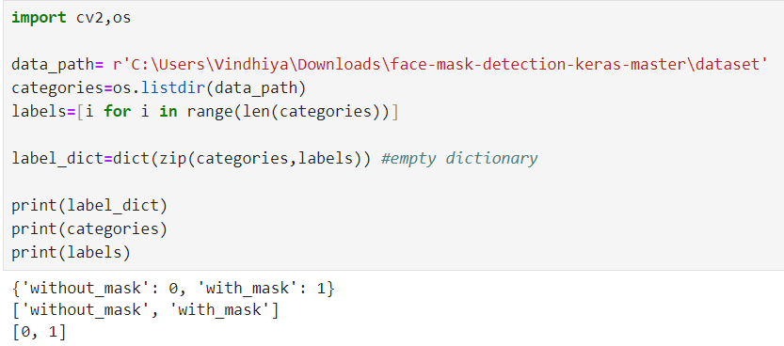
MODELLING
DATA PREPROCESSING
3/21/2024 Annual Review

Slide 10
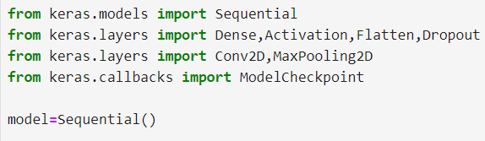
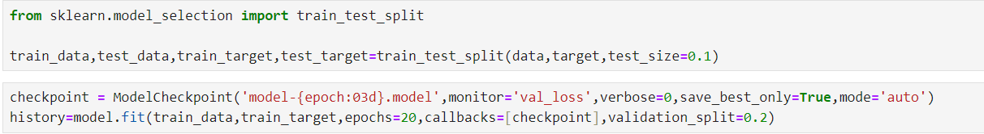
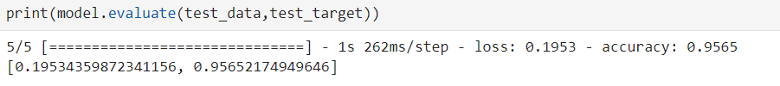
TRAINING DATA

Slide 11
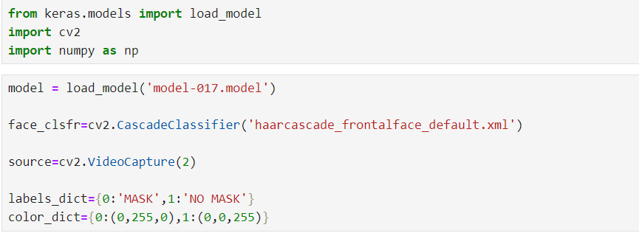
DETECTING MASKS

Slide 12
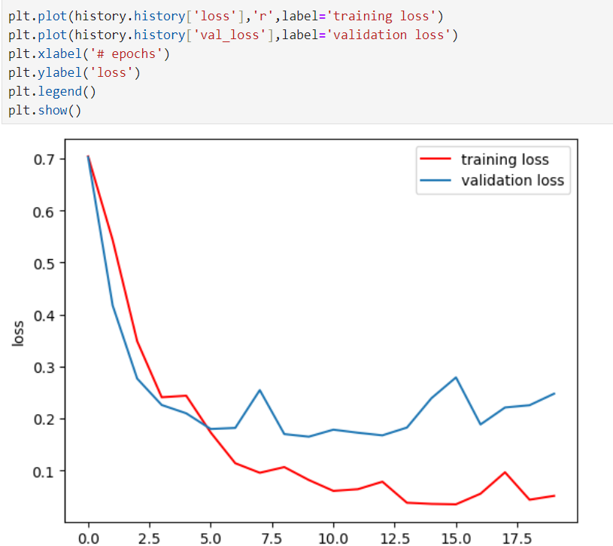
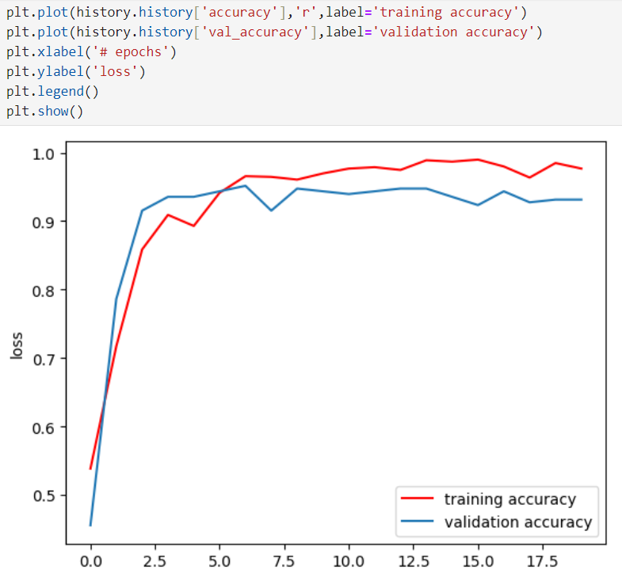
ACCURACY OF THE MODEL

Slide 13
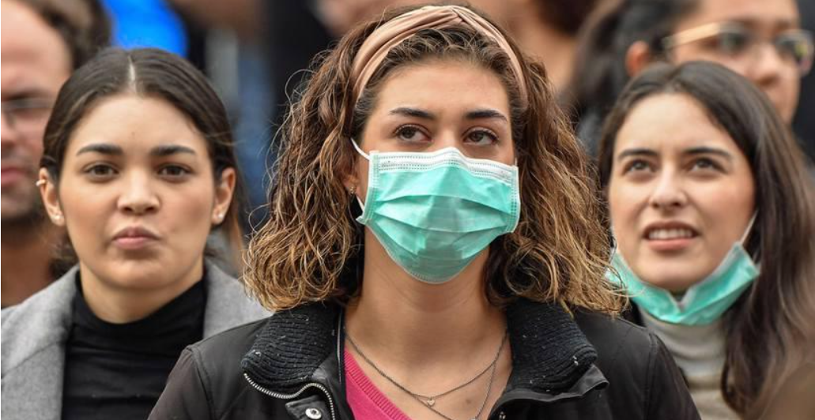
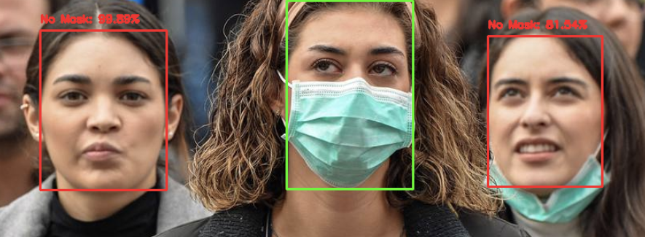
RESULTS
DEMO LINK :
https://drive.google.com/file/d/1b8wl7aIdHwcRF9WPH1XpNheXchyHSBM2/view?usp=drivesdk

